Slide 1
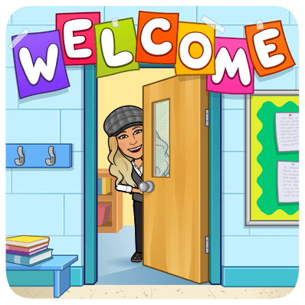
Welcome Back!
2022 – 2023 School Year
Rogers High School

Slide 2
Contact Information for Ms. Usai
Please feel free to contact me with any questions or concerns!
Natasha Usai (she/her)
Email: natashau@spokaneschools.org
Phone: 509.354.6644
Room #: R303
I teach Chemistry and Principles of Biomedical Science. Click the links below for class syllabi.
Chemistry Syllabus
Principles of Biomedical Science Syllabus

Slide 3
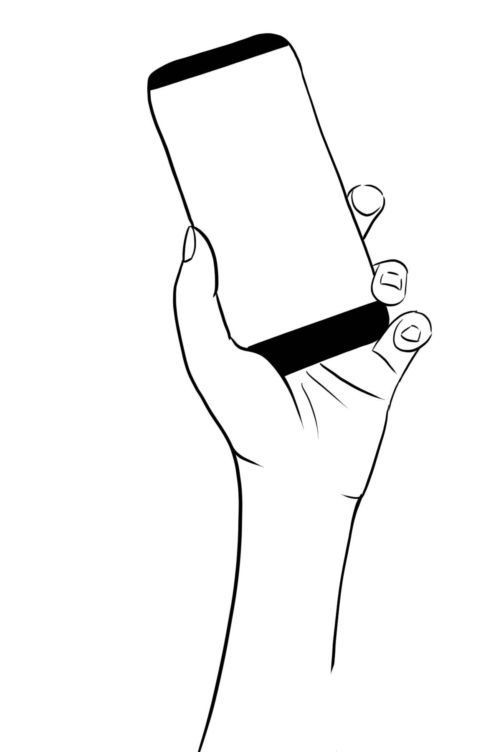
My name is Ms. Usai!
CONTACT INFO
CHEMISTRY
EMAIL: natashau@spokaneschools.org
ROOM #: R303
COURSE DESCRIPTION
This high school level chemistry course includes properties of matter, structure of atoms, bonding, chemical names and formulas, chemical reactions, and calculations involving chemical reactions. Special topics will include states of matter, gas laws, acids and bases, kinetics, electrochemistry, and solution chemistry. The scientific method and problem solving techniques will be emphasized throughout the year.
BE RESPONSIBLE
Come to class on time and be prepared with class materials. Follow class rules and procedures.
BE RESPECTFUL
Respect yourself, your peers, your teacher, and class supplies. Respect is the foundation of this classroom!
DO YOUR BEST
Put effort into your work and participate in class. It’s ok if you try and fail but it’s not ok to fail to try!
SUPPLY LIST
Computer with charger
1 Pack of Colored Pencils
Pencil
2 Glue Sticks
1 Composition Notebook
Scissors
TURN IN...
WARM-UP
CLASS WORK
CLEAN UP
Homework or projects
Short exercises, quick writes, word problems, etc...
Group work, Independent working time, notes, etc...
Pick up materials, return any books or items to the correct location
“Chemistry is thus at once a science and an art.”

Slide 4
TECH POLICY :
All phones, headphones, and ipads must remain in your backpack or on your teacher’s desk unless you are given permission to have them out. If you have been given permission to use tech during class it is NOT to text, call, or engage in social media. Should you have a situation were you need to answer the phone for a parent, you may make a request and take your call in the hallway. Should you break this policy your tech privilege will be revoked permanently.
RESTROOM POLICY :
No passes will be issued during the first and last 10 minutes of class, or during direct instruction time (during work time is okay).. Passes are for emergencies only and should not replace utilizing the time between classes for a restroom.
70%
In this course your grades are broken up into 3 major categories
( Major, Non-Major, and Homework) Each of these categories are weighted differently. This means that a test or major grade will affect your overall average more than a homework grade..
Major Grades: Daily work, Quizzes
20%
Notebook Upkeep & Organization
10%
Tests & Projects
ABSENT?
If you are absent you will have the opportunity to make up the work that you missed. You will have the amount of days you missed to make up your work..
Make Up WORK
Make up work can be completed in free class time, at home, or you may access my help after school by appointment. If you need to attend the HUB to make up your work you will need to receive permission from me and a pass.
Tardy Policy
First Tardy: Logged in Powerschool
Second Tardy: Call Home
Third Tardy: Referral
All future tardies: Referral

Slide 5
My name is Ms. Usai!
CONTACT INFO
PLTW: Principles of Biomedical Science
EMAIL: natashau@spokaneschools.org
ROOM #: R303
COURSE DESCRIPTION
This course will help prepare you for a career in medicine or health care and will challenge you to solve real-world problems. You will work through real-world situations, cases, and problems, such as solving a medical mystery case, diagnosing and treating a patient, and responding to a medical outbreak.
BE RESPONSIBLE
Come to class on time and be prepared with class materials. Follow class rules and procedures.
BE RESPECTFUL
Respect yourself, your peers, your teacher, and class supplies. Respect is the foundation of this classroom!
DO YOUR BEST
Put effort into your work and participate in class. It’s ok if you try and fail but it’s not ok to fail to try!
SUPPLY LIST
Computer with charger
1 Pack of Colored Pencils
Pencil
2 Glue Sticks
1 Composition Notebook
Scissors
TURN IN...
WARM-UP
CLASS WORK
CLEAN UP
Homework or projects
Short exercises, quick writes, word problems, etc...
Group work, Independent working time, notes, etc...
Pick up materials, return any books or items to the correct location
A scientist is someone who is not focused on giving the right answers; they focus on asking the righ questions. – Clause Levi-Strauss

Slide 6
TECH POLICY :
All phones, headphones, and ipads must remain in your backpack or on your teacher’s desk unless you are given permission to have them out. If you have been given permission to use tech during class it is NOT to text, call, or engage in social media. Should you have a situation were you need to answer the phone for a parent, you may make a request and take your call in the hallway. Should you break this policy your tech privilege will be revoked permanently.
RESTROOM POLICY :
No passes will be issued during the first and last 10 minutes of class, or during direct instruction time (during work time is okay).. Passes are for emergencies only and should not replace utilizing the time between classes for a restroom.
80%
In this course your grades are broken up into 2 categories
( Major and Non-Major). These categories are weighted differently. This means that daily work in you INB, labs, and projects will affect your overall average more than a homework or quiz grade.
Major Grades: Daily work INB, Projects, Labs
20%
Non-Major Grades: Quizzes, Homework
ABSENT?
If you are absent you will have the opportunity to make up the work that you missed. You will have the amount of days you missed to make up your work..
Make Up WORK
Make up work can be completed in free class time, at home, or you may access my help after school by appointment. If you need to attend the HUB to make up your work you will need to receive permission from me and a pass.
Tardy Policy
First Tardy: Logged in Powerschool
Second Tardy: Call Home
Third Tardy: Referral
All future tardies: Referral

